Slide 1


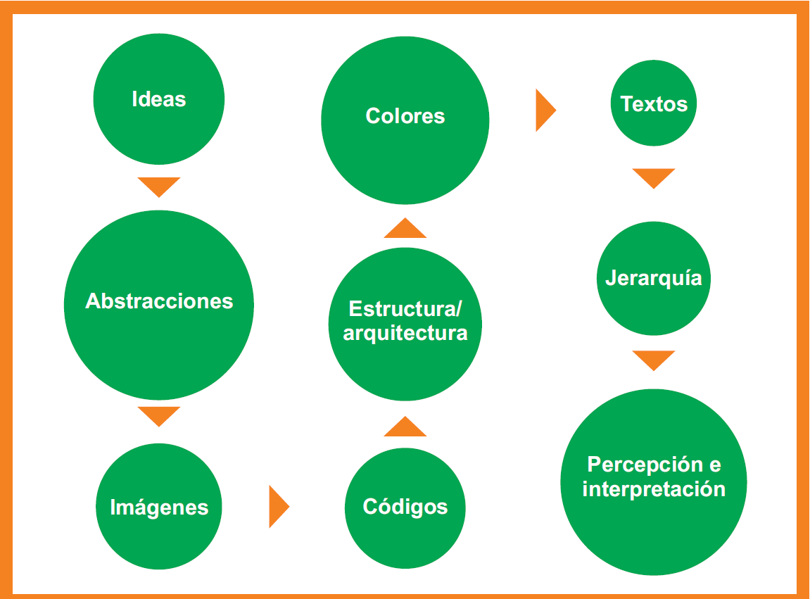
Title of Presentation Initials lastname¹, Initials lastname² ,…(Note: the superscript indicate the affiliation of each author, if all belong to the same institution is not necessary collocate) ¹Name of Faculty, Institution, City, Country Faculty address ²Escuela de Ciencias de la Ingeniería y Tecnología, Universidad Autónoma de Baja California, Tijuana, México email contact
Abstract
The poster abstract structure is the same of the oral communication and, if the work or research permit, must include: 1. Problem or justification. 2. Project objective 3. Methodology (materials and methods). 4. Results. 5. Conclusions. The abstract must comply with: easy understanding (is not necessary resort to another source). Must contain essential points of the work, research or experience. Had a limit extension (maximum 300 words). Has to be clear and brief, accurate and concise; that's why short sentences should be used, thus, select appropriate words. The abstract is a “short article”. As consequence, it should not contain: 1. No essential information. 2. Detailed descriptions. 3. Too many results. 4. Information that will not be included in the poster.
Introduction
It helps the reader to become familiar with the theme and redaction, must be short and concise. The aspects to be considered:
Background, revision (short) of the theme.
Theoretical importance or theme practical.
Hypothesis.
Objective of the work.
Definition (define some terms in some cases may be necessary).
Type and size
Do not use only capital letters. When a reading is done, the reader generally identifies shapes; if all letters look alike, its hard to distinguish them.
Use “simple” types of letters, for example: Arial or Helvetica, and no more than two type of letters in the poster.
Be careful with the justification. Consider if the text is justified on both side can be large spaces between words.
It is not advisable to use underlining (Works underlining are not appreciated from afar).
To highlight the text its better to use italics or bold.
Below are some suggestions about the size and letter type.
Title: understand from afar (from 1,5 m to 2 m of distance) here are some suggestions:
− Bold.
− Size: almost 60.
− Proportional to the rest of the text.
Authors: Size less than the tittle
Suggestions:
− Bold.
− Size: 48
Affiliation of the authors: less tan the authors.
Suggestions:
- Bold.
- Size: 28
Tittle of sections
Suggestions:
− Bold.
− Size: 36
Text: Suggestions:
− Do not use bold.
− Size: 28
Results
The poster includes an abstract of the results, once analyzed, whether if the formulated hypothesis has been proved or not. The data will be selected by it relevance and relation with the study objective.
Procure to avoid long texts, with many data. The use of tables and figures in this section is very useful. (see the section for figures, shapes, picture and artwork.)
Figure 1. Bases for a good design of figures. (size 24, center, at the bottom of every figure).
Figure 2. Graphic example (size 24, center, at the bottom of every figure).
Table 1. Table format (size 20, center, at the head of every table).
Shapes, figures, pictures, illustrations, etc.
The poster it’s a medium very suitable for the use of graphic resources. For this reason there are few poster where only text is used.
The exact balance between text and pictures contribute the “success” of the poster. Any type of graphic representation (figures, pictures, draws) must be of extreme quality (otherwise not include themes).
The figure can be the best way to present data, summarize information and to communicated. Sometimes, a shape can do these same function, but its preferable uses figures.
It has to be simple and with an ideal size so it can seen without “sticking it” to the poster. The color add impact.
It can be useful include schemes that facilitate the understanding concepts. The 3D graphics can be difficult to understand than the 2D, it is not recommended to use 3D.
Conclusions
In general, the poster include a conclusion section (sometimes after the tittle, the reader goes to the conclusions).
This section should never be forgotten. Also, it can include a discussion and interpretation of the results, recommendation for futures works, suggestions, etc.
In any case, one has to be very objective at the time of writing both the discussion and the conclusions.
References
The format of the references should be with IEEE style and it can be use the Endnote or Mendeley as reference manager
[1] D. RA., How To Write and Publish a Scientific Paper, 6th ed. Phoenix: Oryx Press, 2006.
[2] E. Guardiola, “El poster científico,” in Presentaciones orales en Biomedicina. Aspectos a tener en Cuenta para Mejorar la Comunicación, 1st ed.,
[3] E. Seres, L. Rosirch, and F. Bosch, Eds. Barcelona: Cuadernos de la Fundación Dr. Antonio Steven, 2010, pp. 85–102.
Acknowledgments
It is not obligatory, but it could be considered, a small section included to mention those people who have participated in the work but that can not be considered authors, to organizations, companies or societies that have financed the work or that have contributed of some form, etc.
a)
b)
Methodology
This section should allow the reader to evaluate the way the work was carried out. It should describe what was done to obtain, collect and analyze the data; That is, the study design, how it was carried out, whether it had different phases, what variables were considered, how data was analyzed (statistical analysis, if any), etc. Block diagrams or experimental arrangements may be included.

